Slide 1
Code Coverage Improvement &
Continuous Integration Dynamic Regression
Video Software Solution (VSS) Automation Team:
Leon Zhao, Abdelillah Asraoui , Hop Le, Peter Yu, Alan Pham,
Mohammad Islam, Alejandro Avella, Eric Thorbjornsen
October 22, 2013

Slide 2

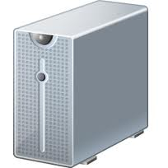
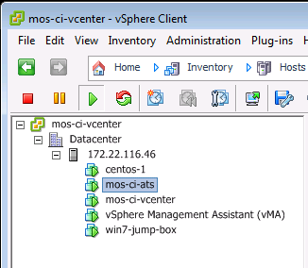


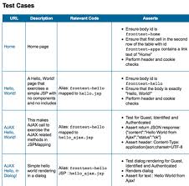

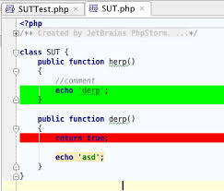
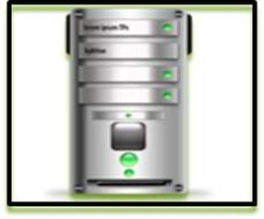

Code Coverage Improvement and Continuous Integration Dynamic Regression Flow Diagram
Execute reduced test suite BASED ON CHANGES
Continuous Integration
Continuous Integration
Dynamic Regression
Goal 1:Reduce Test Execution time
Build Server
creates image
Mapping
Source files to test cases
More test
Cases to pool
New code commit
Rally Db
Goal 2: Increase Test Coverage
Test Plan augmented
Code Coverage Report e.g. Jacoco
Code Coverage Improvement Tool (CCIT)

Slide 3
Agenda for Code Coverage Improvement
Motivation
Objectives
Approach & Methodology
Overview Flow Diagrams
Project Deployment
Development & Regression Environments
Setup Requirements
Analysis & Measurements of Code Coverage Data
Using Code Coverage as an Automation Metric
Demo
11. Q & A

Slide 4
Motivation
One of the Key Challenges for Development Test is to determine whether enough testing has been done to deliver high quality software release
Let’s say we have X number of test cases during UT/FT test cycles
What does it really mean ?
Is this sufficient ?
Can we say that we are done testing ?

Slide 5

Motivation Cont.
With All these questions in mind the following metrics in the Code Coverage Data are IMPORTANT:
The Amount of code the test cases are covering
(# Lines covered/missed)
The possible code paths coverage
(#Branches missed)
We need to move away from Blind Testing to Intelligent Testing
This requires a Process Change

Slide 6
Objectives
CCIT Tool which provides the following capabilities in Automation Testing:
Code Coverage Measurements
(Lines, Branches Covered/Missed)
Code Coverage Data Analysis
Code Coverage Gap Identification and Improvement
Algorithmic search to Add and Re-design new and existing
test Cases
Mapping of Source Code Components to Test Cases in a Database

Slide 7
Approach & Methodology
CCIT Tool addresses the Gap and Improves the Code Coverage by:
Parsing the code coverage report and identifying the modules, files and functions with missed lines and branches of the code.
Creating the User Stories mapping of Modules and functions to Test cases in a Database in order to generate use cases and translates these to test cases.
Providing Modules/functions mapping to test cases for Continuous Integration system.

Slide 8
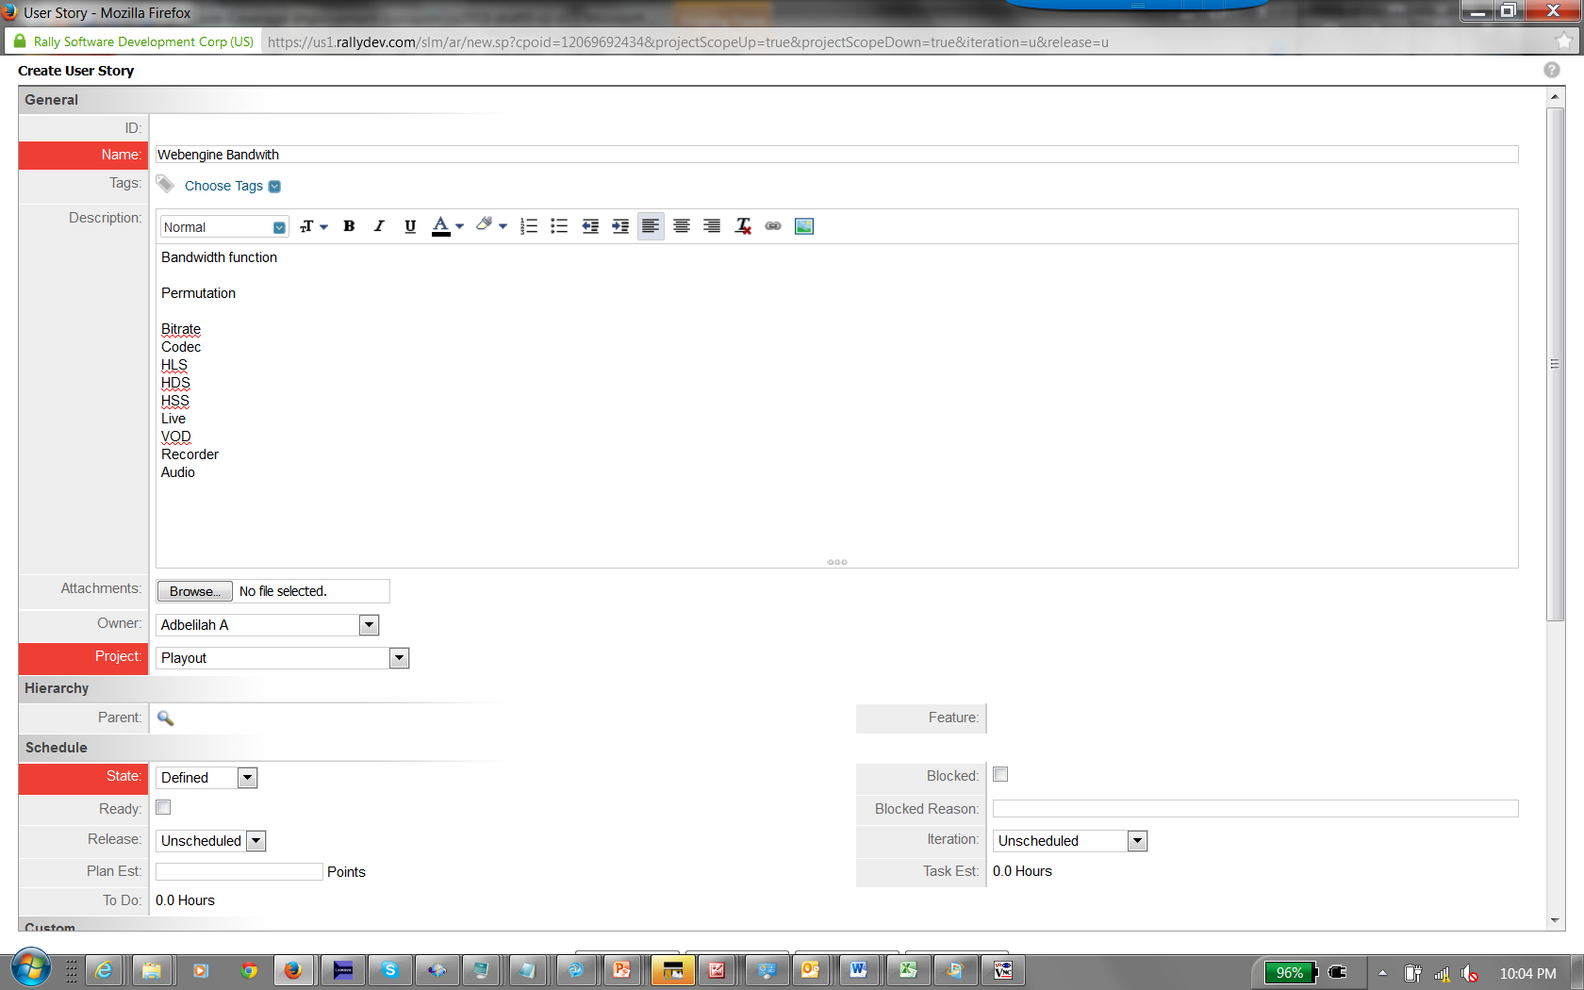

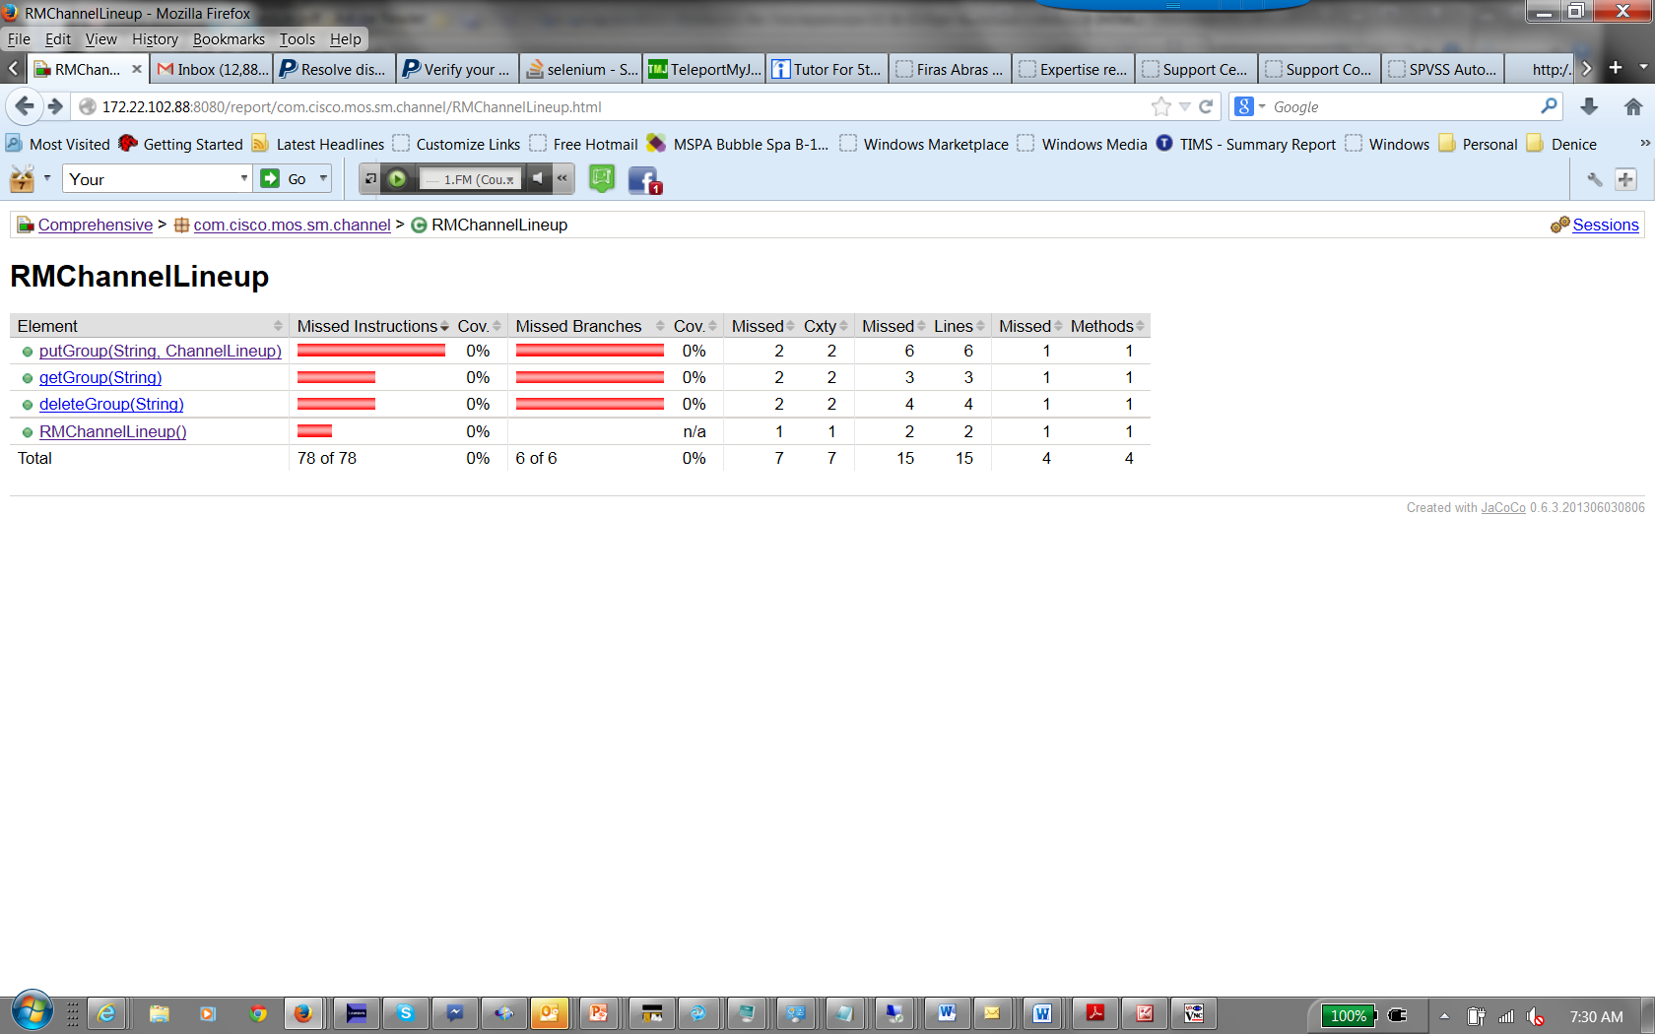

Code Coverage Improvement Tool &
Continuous Integration Dynamic Regression Overview Diagram
Jacoco CC Report
Feature Description
Continuous Integration Dynamic Regression
(CIDR)
Database New Test Cases / User Story Mapping functions: fn1() Tc bitrate Tc_content .. Tcn
Code Coverage Improvement Tool (CCIT)

Slide 9
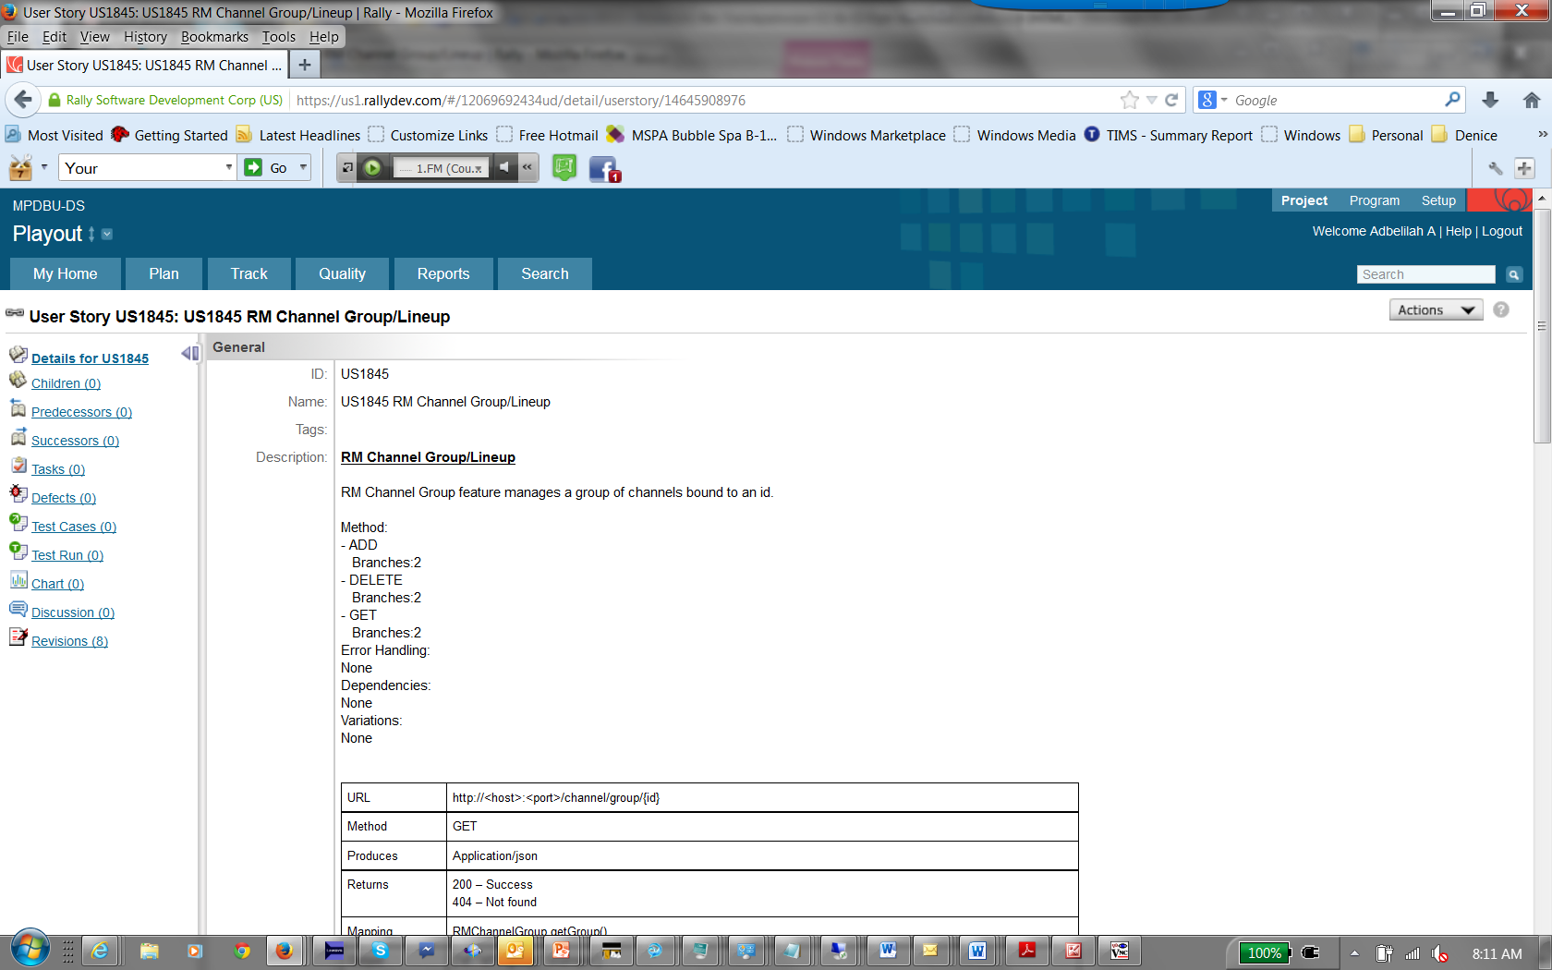
Rally User Story Description

Slide 10
CCIT Algorithmic Search
CCIT uses input from User Story description along with Tags/keys defined in the source code:
Methods, Variations, Dependencies and Error Handling.
Methods are also defined in the source code as in:
“@Annotation (id) Delete”
Extract these keys to generate new uses cases and scenarios.

Slide 11
CCIT Algorithmic Search Cont.
RM Channel
ADD, MODIFY …
RM Channel Group
ADD, DELETE, MODIFY
putGrp
ADD
MODIFY
Executing ADD use case , CC = 50%
Executing MODIFY use case => CC = 100%

Slide 12
New Database Mapping
Format:
User Story id
Modules functions
Source Code
Methods/Dependencies
Conditions/Variations
Error Handling
Test Cases

Slide 13
CCIT/CIDR Flow Diagram Steps
1. CCIT Parses in the Coverage Report in html or txt format
2. Identifies Modules and Functions with low coverage data
3. Parses User story Functions descriptions & Test cases mapping in a DB (Rally User Stories)
4. Generate use cases and translates these to test cases
5. Provides this mapping of Modules/functions & Test cases to CIDR
6. CIDR uses the Mapping for Dynamic Regression Selection.
7. For the Legacy code, CIDR uses Functions/Test Cases Mapping obtained from reverse engineered code coverage.
8. When a new code change commit, CIDR will select the targeted test cases corresponding to the actual code change.
9. CIDR sends a notification when test report is completed.

Slide 14
CCIT / CIDR Flow Diagram Steps
Code Coverage
Report
Module1
fn1() 5%
fn2() 20%
fn3() 98%
…..
fnn() 14%
Continuous Integration
Dynamic Regression
(CIDR)
Test Suite
US100
Fn1()
Tc1…Tcn
New Code Commit
Test Report Email Notify
DB Rally User Story functions Mapping to test cases
Description
US100
Bandwith function
fn1()
Dependencies/Variations
Bitrate
Content
DB New Test Cases/ User Story Mapping:
US100
fn1()
Tc_bitrate
Tc_content
Tcn
Legacy code Existing Test Cases
Mapping to functions Based on CC
Code Coverage Improvement Tool
(CCIT)

Slide 15
Project Deployment
CCIT initial project deployment:
MOS 2.0 / SM Sprint 2
Coverage Data from UT test cases
Use Case Demo

Slide 16
Development Environment
Coverage Data Report
Unit Tests Run
Src build
Code Coverage Tool e.g
Jacoco
Instrumented
War file
Byte code

Slide 17
Devtest Environment
Web Container with
Jacoco Agent
Client DT scripts
4.
Instrumented War file 3.
Jacoco Agent 2.
Coverage Data Report 5.
Client 1. Apache Server

Slide 18
Setup Requirements e.g. Java Environment
Linux Client wih ATS server installed (scripts)
Build Server with Jacoco & Jenkins installed
Web Container with Jacoco Agent

Slide 19
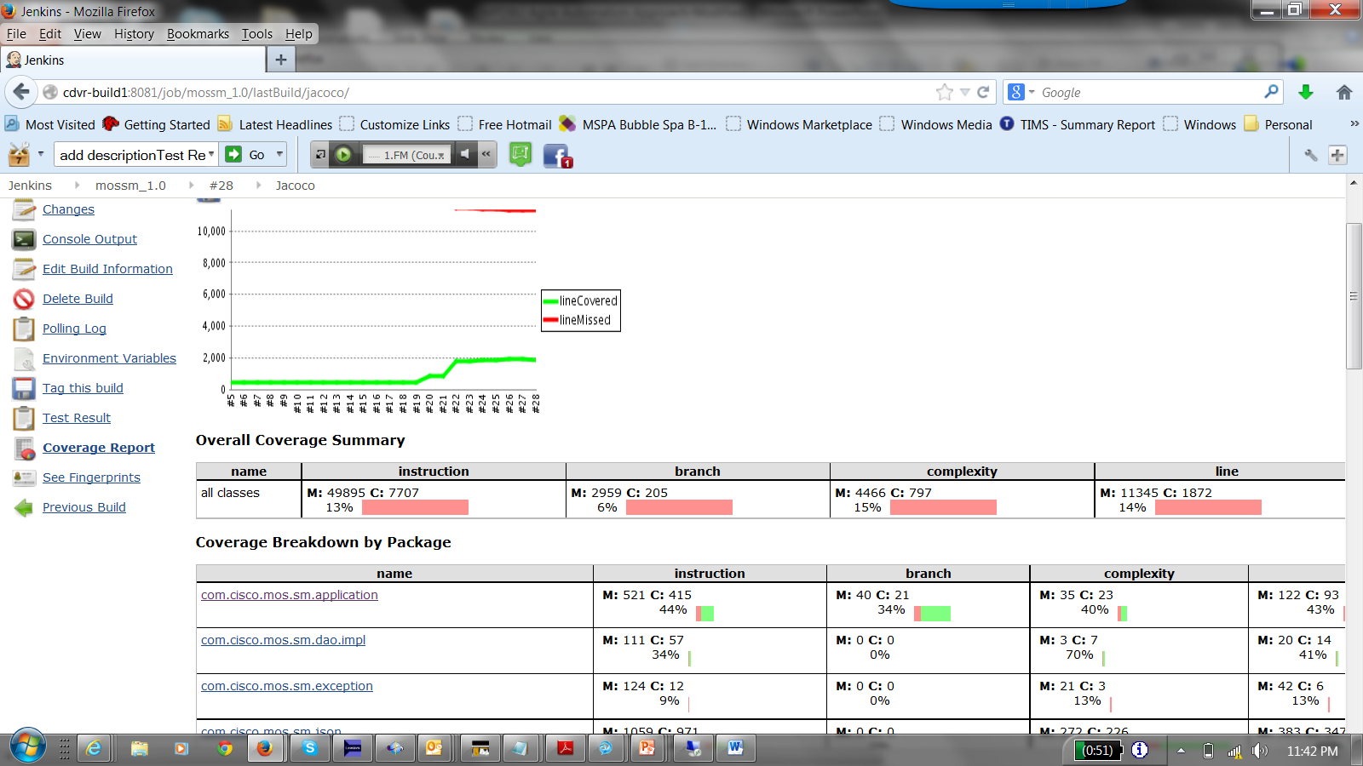
Jacoco Code Coverage Data per Module

Slide 20
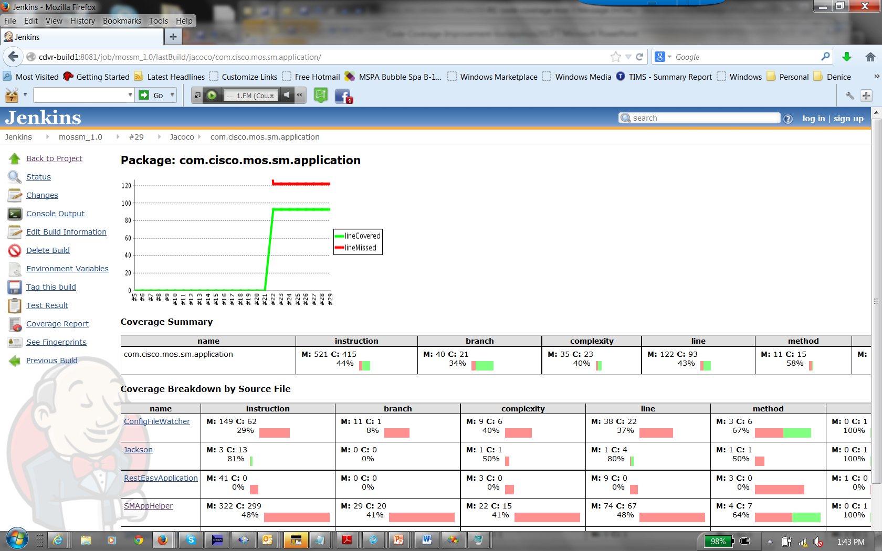
Jacoco Coverage Data Per function

Slide 21
Using Code Coverage as an Automation Metric
At the End of each Agile Sprint Test Cycle , Code Coverage
metric will include:
# Lines Covered/ Missed per User Story
# Branches Missed per User Story
http://mpd-lnx1.cisco.com/cgi-bin/MPDBU/dashboard.cgi

Slide 22
CCIT Demo

Slide 23
CCIT Demo Cont

Slide 24
CCIT Demo Cont
1. curl -H "Content-Type: application/json" -X POST --data @json_file_report http://172.22.102.88:8080/jacoco/coverage/reset
2. curl -H "Content-Type: application/json" -X PUT -d @json_file1 http://172.22.102.86:8080/sm/channel/group/104 -v
3. > curl -H "Content-Type: application/json" -X POST --data @json_file_report http://172.22.102.88:8080/jacoco/coverage/report

Slide 25
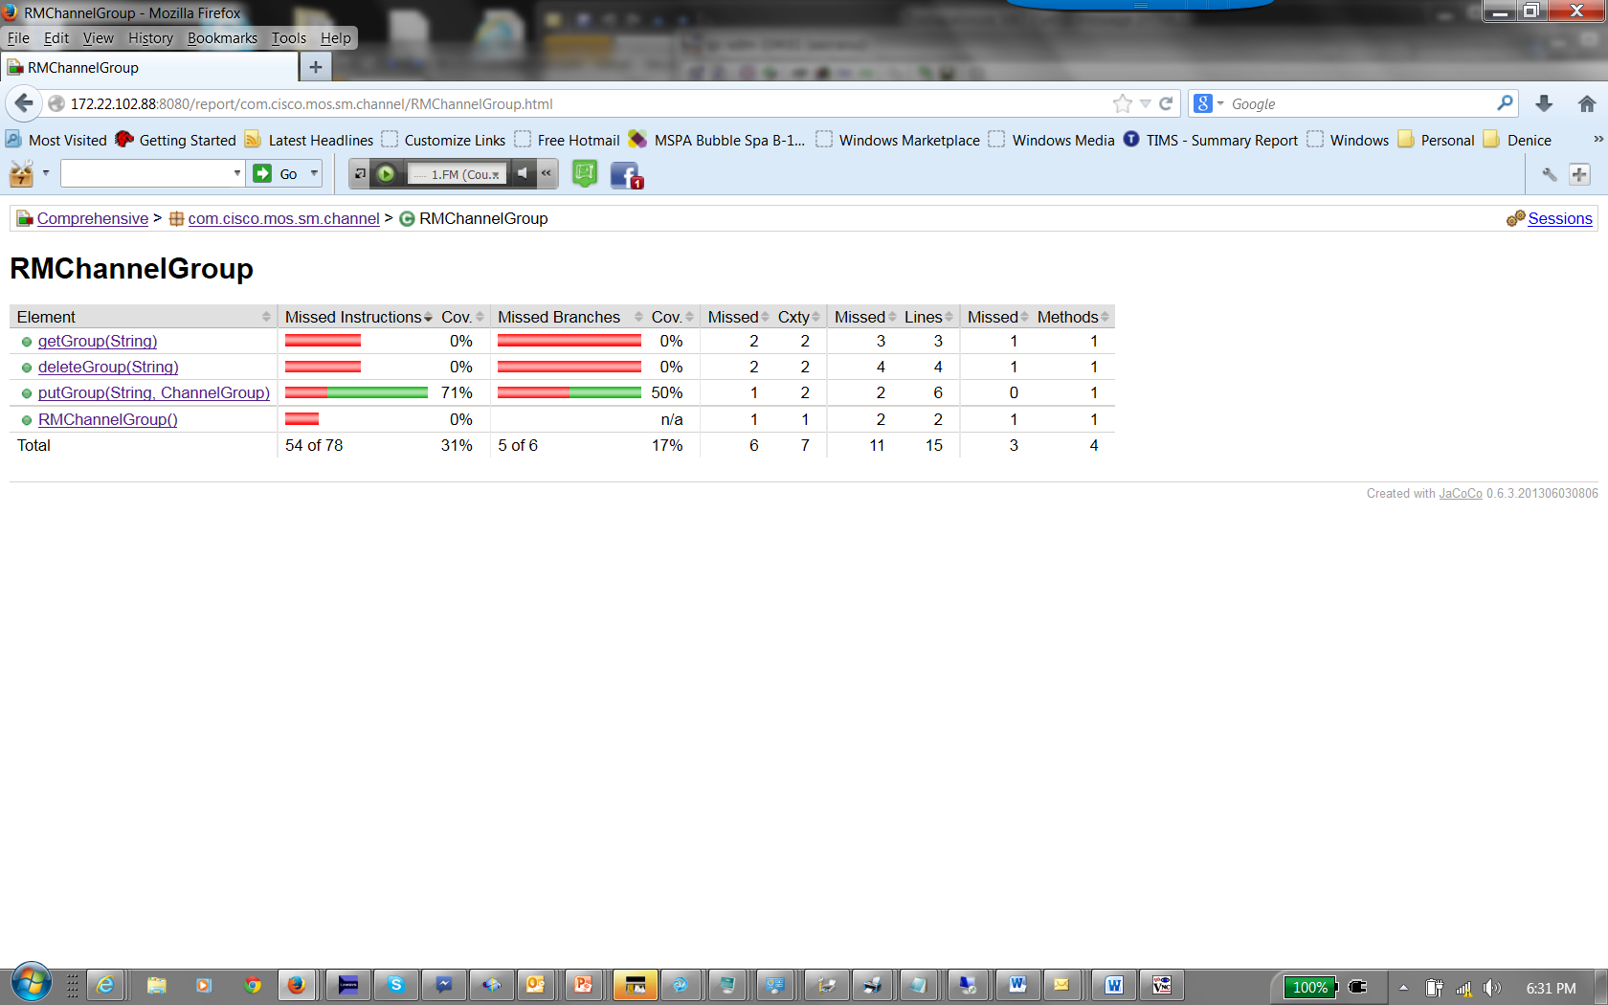
CCIT Demo Cont

Slide 26
CCIT Demo Cont
1. curl -H "Content-Type: application/json" -X PUT -d @json_file2 http://172.22.102.86:8080/sm/channel/group/104 -v
2. curl -H "Content-Type: application/json" -X POST --data @json_file_report http://172.22.102.88:8080/jacoco/coverage/report

Slide 27
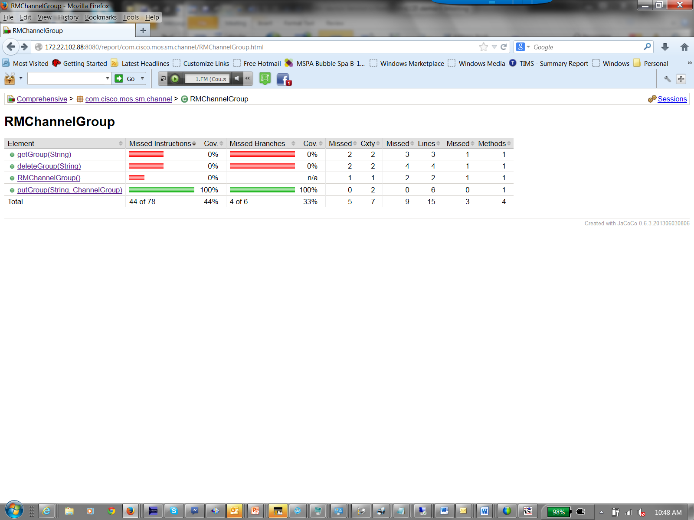
CCIT Demo Cont

Slide 28
CCIT Demo Cont
1. curl -H "Content-Type: application/json" -X GET http://172.22.102.86:8080/sm/channel/group/104 -v
2. curl -H "Content-Type: application/json" -X POST --data @json_file_report http://172.22.102.88:8080/jacoco/coverage/report

Slide 29
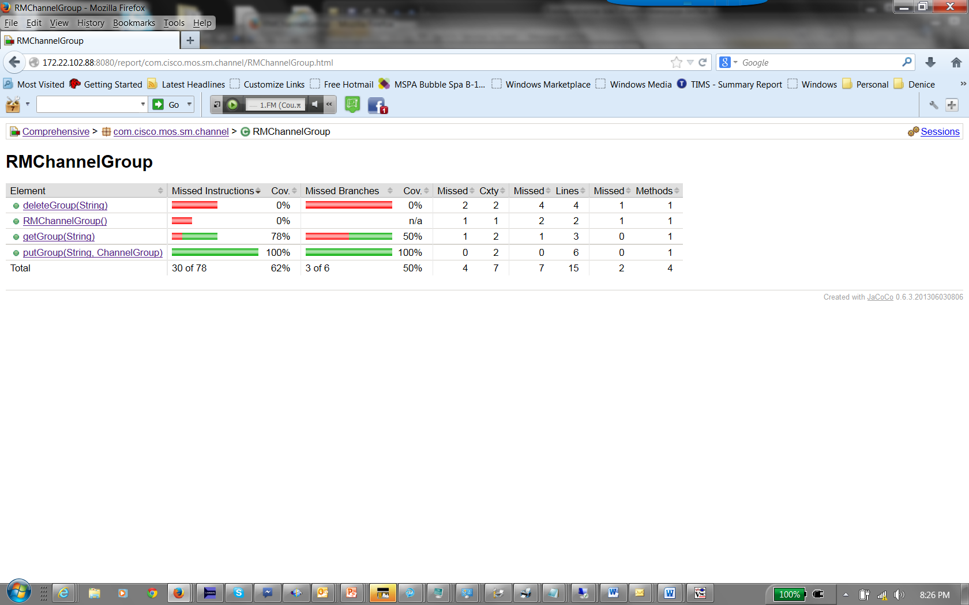
CCIT Demo Cont

Slide 30
CCIT Demo Cont
1. curl -H "Content-Type: application/json" -X DELETE http://172.22.102.86:8080/sm/channel/group/104 -v
2. curl -H "Content-Type: application/json" -X POST --data @json_file_report http://172.22.102.88:8080/jacoco/coverage/report

Slide 31
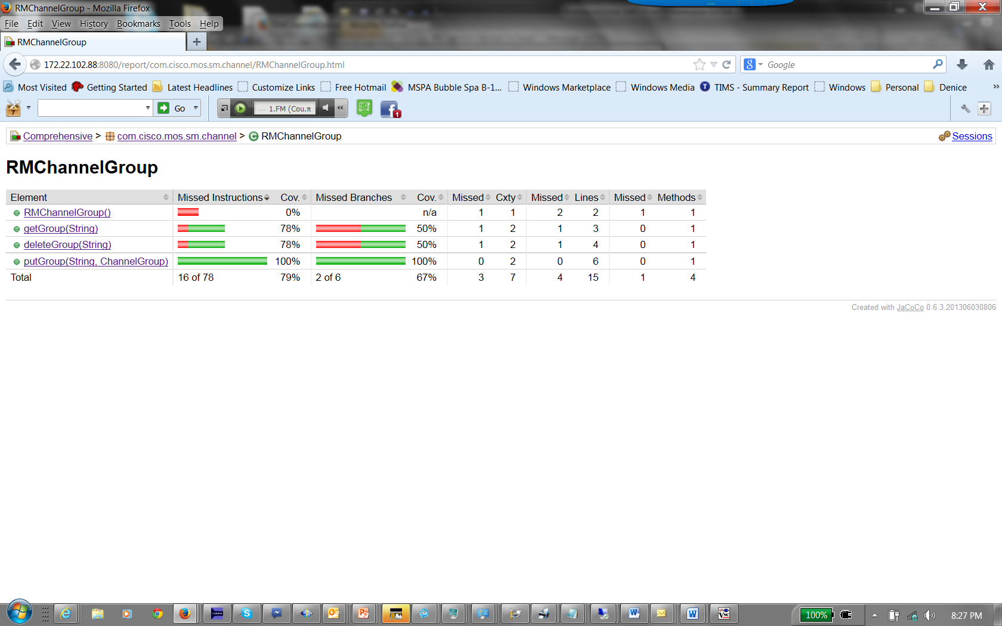
CCIT Demo Cont

Slide 32
CCIT Demo Cont
1. curl -H "Content-Type: application/json" -X GET http://172.22.102.86:8080/sm/channel/group/104 -v
2. curl -H "Content-Type: application/json" -X POST --data @json_file_report http://172.22.102.88:8080/jacoco/coverage/report

Slide 33
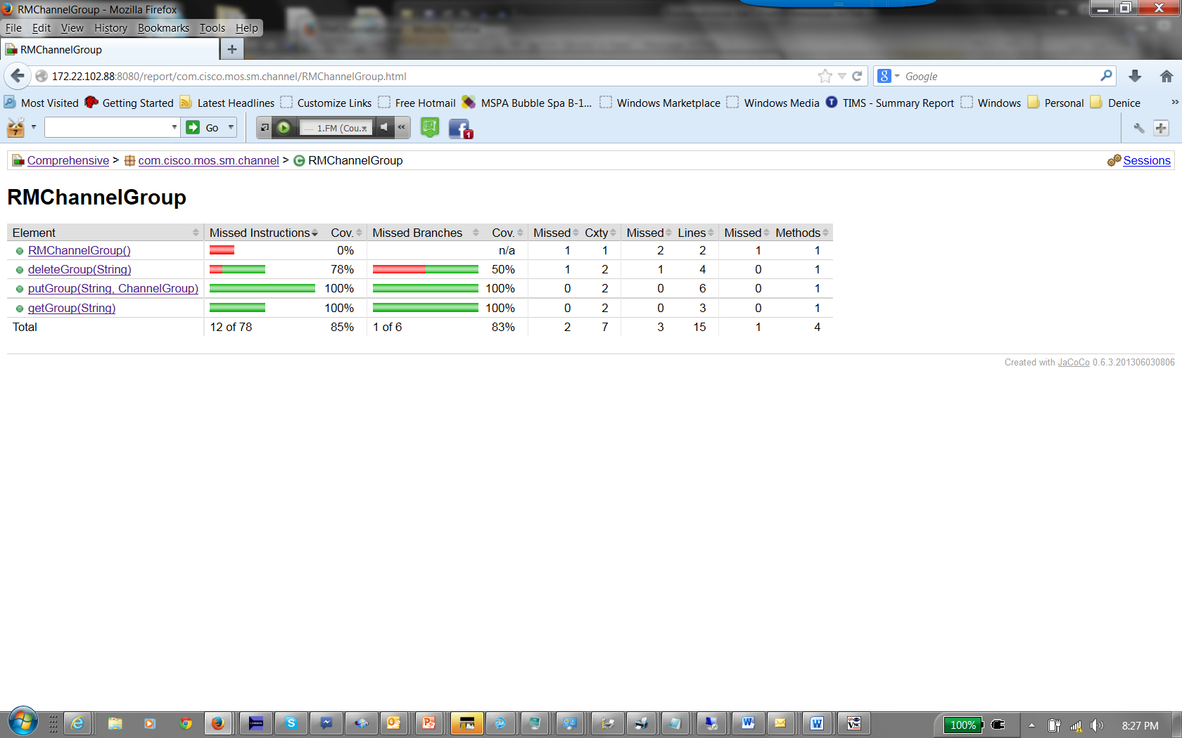
CCIT Demo Cont

Slide 34
CCIT Demo Cont
1. curl -H "Content-Type: application/json" -X DELETE http://172.22.102.86:8080/sm/channel/group/104 -v
2. curl -H "Content-Type: application/json" -X POST --data @json_file_report http://172.22.102.88:8080/jacoco/coverage/report

Slide 35
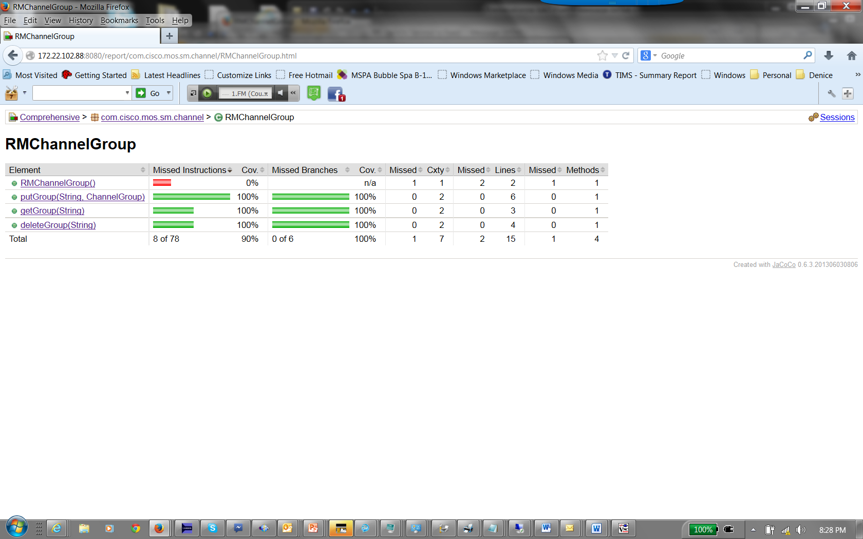
CCIT Demo Cont

Slide 36
CCIT Demo Cont
Webex Recording:
https://cisco.webex.com/ciscosales/lsr.php?AT=pb&SP=MC&rID=72380902&rKey=99ffc309dc5dc02c

Slide 37
Code Coverage Improvement Tool Flow Diagram
Database New Test Cases / User Story Mapping functions: fn1() Tc bitrate Tc_content .. Tcn
Code Coverage Report
Rally User Stories
Code Coverage Improvement Tool (CCIT)

Slide 38
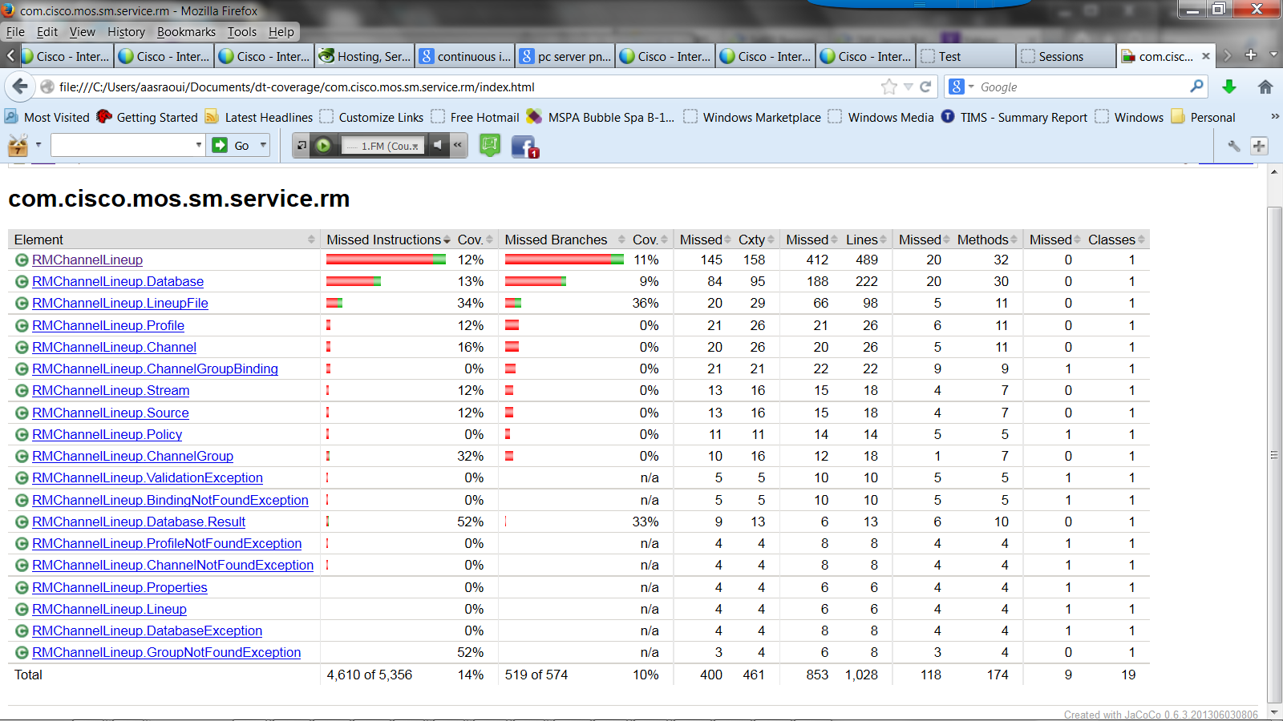

Slide 39
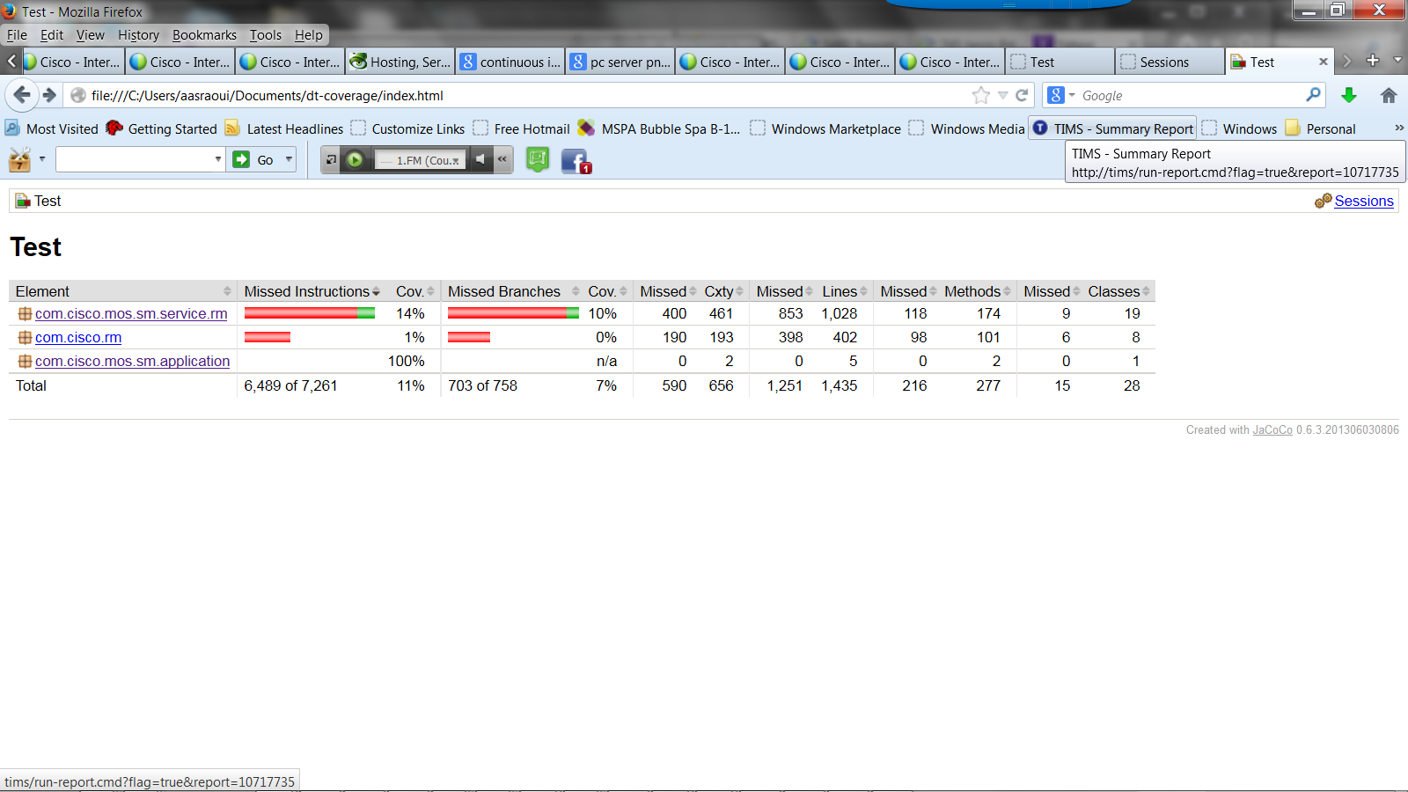

Slide 40
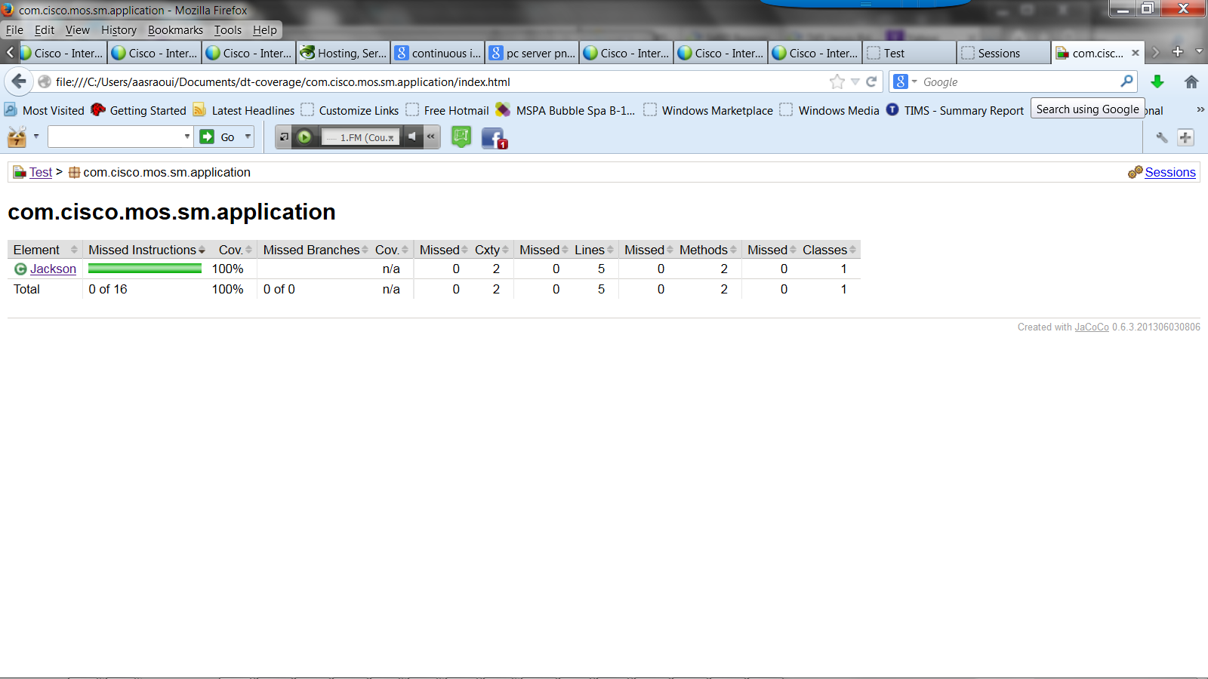

Slide 41
Q & A

Slide 42
Thank you

Slide 43
Backup

Slide 44
CCIT Flow Diagram Steps
Code Coverage Report
Module1
fn1 0%
fn2 20%
fn3 98%
…..
fnn 14%
CI
(Continuos Integration)
Dynamic Regression
Selection Test Suite
US100
Tc1…Tcn
CCIT
DB
Rally User Stories
US100
fn1
fn2
fn3
…..
fnn
New Test Cases/ User Stories
Modules
US100
Tc1
Tc2
..
Tcn

Slide 45
CCIT Flow Diagram per Function Steps
Code Coverage Report
fn1() 5%
CI
(Continuos Integration)
Dynamic Regression
Selection Test Suite
US100
Fn1()
Tc1…Tcn
CCIT
DB
Rally User Story
Description
US100
Bandwith function
fn1()
Permutations
Bitrate
Content
Mode
DB New Test Cases/ User Story Mapping:
US100
fn1()
Tc_bitrate
Tc_content
Tcn

Slide 46
Modules/Functions Mapping with User Stories
Database
Code Coverage Report ---------------- Rally User Stories
Module1 8%
Module2 4%
Module3 2%
Module4 62%
…..
Modulen 44%
Module1
fn1 0%
fn2 20%
fn3 98%
fn4 100%
…..
fnn 14%
US100
fn1
fn2
US200
fn3
fn4
…..
fnn
Test Cases
Tc1
Tc2
Tc3
Tc4
…..
Tcn

Slide 47
Continuous Integration Dynamic Regression
SP Video Software Solution (SPVSS) Automation Team
October 14, 2013
EDCS-1263540

Slide 48
Agenda for Continuous Integration
Motivation
Basic concepts
Benefits
Continuous Integration today
Flow diagram
Continuous Integration with Dynamic Regression
Flow diagram
Steps
Mapping source code to test cases
Changes, Select and Schedule module
Demo
Jenkins user interface

Slide 49
Motivation
When many people are working on a project in parallel, there is an “integration problem”
How to ensure that the work done separately can be “integrated” successfully?
Levels of the integration problem:
Merge conflicts: people have modified the same file concurrently.
Compile conflicts: No merge conflicts, but people have modified files concurrently such that the resulting system does not compile.
Test conflicts: No merge conflicts, no compile conflicts, but people have modified files concurrently such that the system does not execute successfully.
Developers need to find if they broke the code as soon as possible
CI is now more important than ever, since we are working on Agile environments

Slide 50
Definition of Continuous Integration
Build and test as soon as there are changes committed
The system must be able to be built and tested automatically
The system must be under version control
Everyone commits their changes frequently (every day or two)
Upon commit, the system is immediately and automatically integrated
Compiled, tested, etc.
Problems are uncovered and developers notified

Slide 51
Benefits of Continuous Integration
Reduced risk: system always builds, or else you know it quickly
Bugs and problems discovered closer to the point in time that they were introduced
System is deployable more frequently, enabling more user feedback

Slide 52
Continuous Integration today
Today, in a continuous integration system such as Jenkins:
The tool monitors a version control system
Builds a new image when there are changes committed by a developer and;
Triggers an automated testing job with ALL or a predefined, static subset of test cases that may not be related to the changes introduced in the build.
This is inefficient testing and it is time consuming.

Slide 53
Continuous Integration Flow diagram
deliverable repository
code repository
Jenkins - CI
workspace
build
test
deploy &
publish
code update
report & notify

Slide 54
Continuous Integration Dynamic Regression

Slide 55
Continuous Integration with Dynamic Regression
deliverable repository
code repository
Jenkins - CI
Changes
Select
Schedule
deploy &
publish
workspace
build
Test
code update
report & notify
Notes:
This is efficient testing since it is dynamic, relevant and saves time and money from a fixed regression baseline.

Slide 56
Continuous Integration with Dynamic Regression steps
System finds changes on commit
Relies on mapping of source files to test cases
Executes a subset of the test cases based on committed changes
This is efficient testing since it is dynamic, relevant and saves time and money from a fixed regression baseline.
With Dynamic Regression only a sub-set of the test cases are executed. For example, it could save several hours per run.
Notes:
This system creates a smart regression module that parses the change log file in Jenkins and selects test cases to run.
The mapping of functionality to test cases can be done in text files, using code coverage tools or mapping user stories to test cases.
Finally, a job is scheduled using Cisco standard tools with only a SUBSET of relevant test cases.
This is efficient testing since it is dynamic, relevant and saves time and money from a fixed regression baseline.

Slide 57
Mapping Source Code to Test Cases
For each source file map the test cases to run.
This can be done in different ways:
Manually, in text files
Mapping users stories to test cases in a tool such as Rally
As the output of a Code Coverage Tool to reverse engineer the code
Since Features keep changing, we prefer an automated process
Http.java
Rtsp.java
Gui.java
test_001
test_001
test_002
test_002

Slide 58
Changes, Select & Schedule Module
Changes
Select
Schedule
Find last build folder in Jenkins
Find changes in changelog.xml
Find test cases to run based on changes
Find unique list of test cases to run
Create schedule test command dynamically

Slide 59
Demo of Continuous Integration with Dynamic Regressions
Define a continuous integration job in Jenkins
Poll version control every 1 minute
Build server creates a build
Change-Select-Schedule module finds changes
Kick-off feature test cases
Email developers with report
Commit some code for one source file
Check to see that the build is triggered, changes are identified and only a sub-set of test cases are executed
Check ATS report and email generated
Commit some code for a DIFFERENT source file
Check to see that the build is triggered, changes are identified and only a DIFFERENT sub-set of test cases are executed.
Check ATS report and email generated

Slide 60
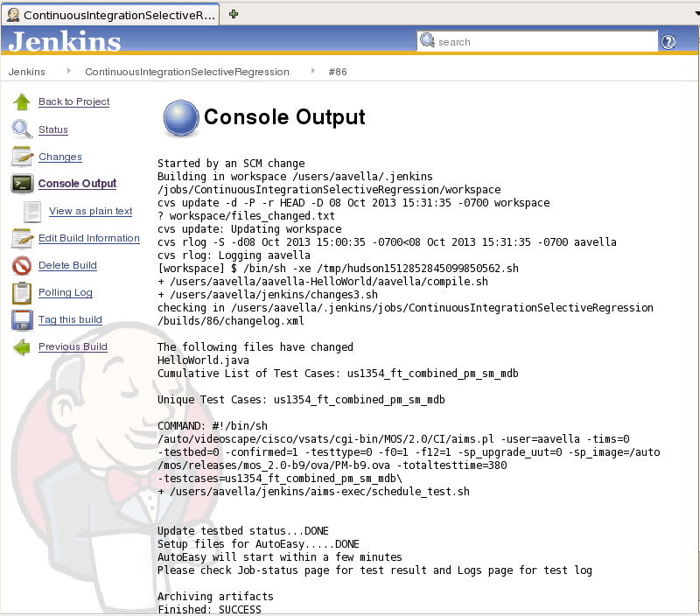
Jenkins GUI

Slide 61
References
Web Site: http://jenkins-ci.org/
Introduction to Continuous Integration http://www.youtube.com/watch?v=4sANX9AhM8c
Patent EP0684557A2 - System and method for selective regression testing - Google Patents http://www.google.com/patents/EP0684557A2?cl=en
Swarnendu Biswas, Rajib Mall, Manoranjan Satpathy and Srihari Sukumaran, "Regression Test Selection Techniques: A Survey", Informatica, 2011 http://www.cse.ohio-state.edu/~biswass/files/informaticasurvey.pdf
W-SRT - Selective Regression Tool Overview and Demo - EDCS-830179
Selective Regression Testing (Lathasree Subramanyan) - IOS DUET - EDCS-572703
PRD for Selective Regression Testing - EDCS-401633
Source-Aware Selective Regression Tooling - Approaches - EDCS-393953
Source-Aware Selective Regression Tooling – Approaches - EDCS-392602
Selective Regression Testing c7600 - EDCS-771056
Selective Regression Testing Readout - EDCS-445347
Runtime Instrumentation for SRT (Selective Regression Testing) - EDCS-909378
IOS Dependency Parser for Selective Regression - Func/Sys Spec - EDCS-683136
SRT(Selective Regression Testing) - Phase II - EDCS-383466

